Slide 1
There is
There are
Notes:
TG: use this presentation to explain the difference between there is and there are AND to explain when we use there is and there are

Slide 2
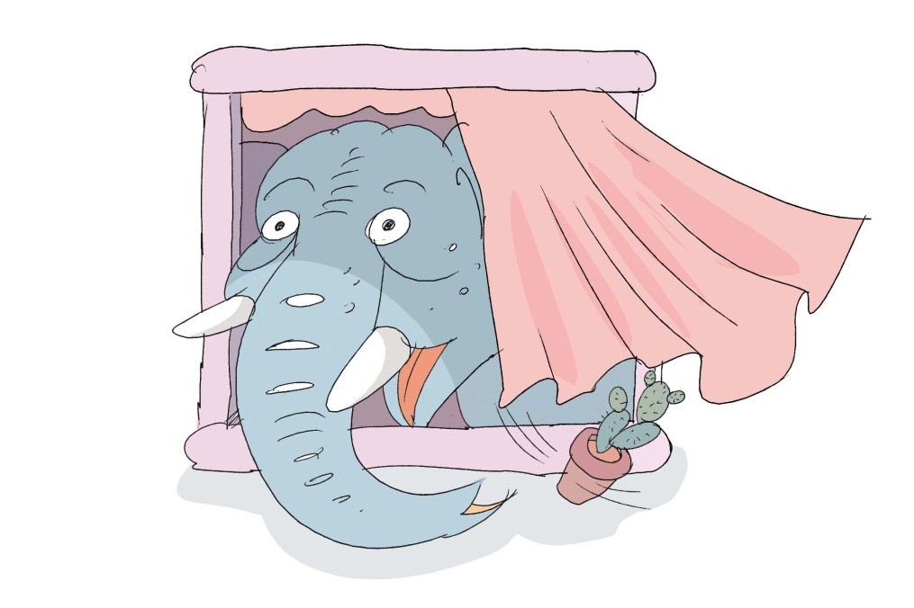
There is …
We use ‘There is’ when we talk about one object that we can see.
For example:
  There is an elephant in the window.
Notes:
Explain there is – we use it for singular objects, hence the ‘is’.

Slide 3
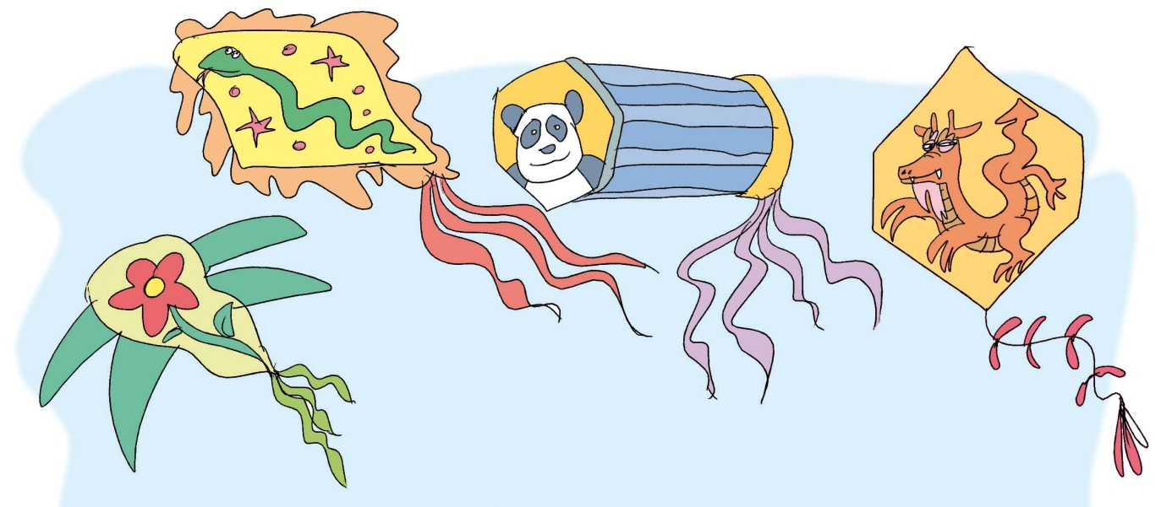
There are…
We use ‘There are’ when we talk about more than one object that we can see.
For example:
  There are kites in the sky.
Notes:
Explain there are, we use it for plural objects, hence ‘there are…’

Slide 4
Now you try!
Now you try.
You have to match the beginning of the sentence to the end.
Write your answers in your notebooks.
When you are ready, click on the mouse to see the answers.
Let’s get started. Click here.
Notes:
Have the students work on their own.

Slide 5
There are
There is
There are
There are
There is
There is
a kite in the sky.
six pandas in the park.
a chocolate cake on the table.
a dragon in my room.
many children in China.
animals in the parade.
Check yourself
When you’re finished and you checked your work, go on to the next slide and do the task there.

Slide 6
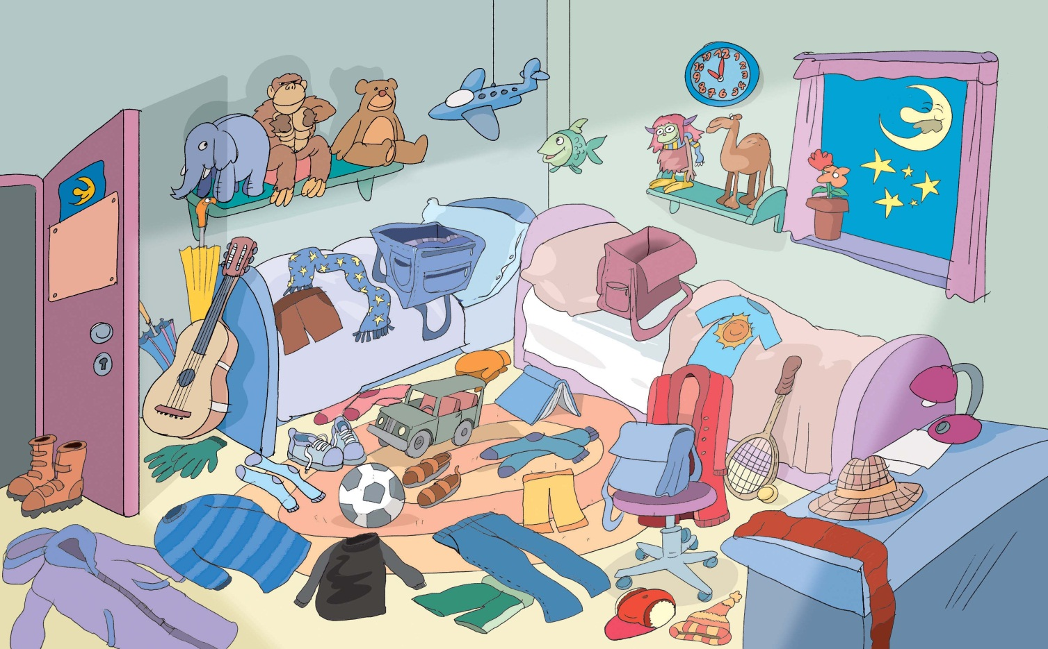
Describe the room in the picture above in your notebook. Write at least 5 sentences using ‘There is’ and ‘There are’.
Notes:
Have the students describe the picture of the room, saying what they see, using ‘there is’ and ‘there are’. For example, There is a ball on the floor. OR There are socks on the floor.

Slide 7
There is a kite in the sky.
There are six pandas in the park.
There is a chocolate cake on the table.
There is a dragon in my room.
There are many children in China.
There are animals in the parade.
Back

